Slide 1
STAT 7900: Special Topic:
Causal Analysis
Instructor
Dhrubajyoti Ghosh
KENNESAW STATE UNIVERSITY
STAT 7900

Slide 2
Recap: Propensity Scores & Matching
1. Confounding
2. Propensity score
3. Matching
Treatment groups differ before treatment.
Summarize treatment assignment using baseline X.
Compare treated and control units with similar treatment probabilities.
Matching changes WHO we compare.

Slide 3


Recap: Propensity Scores & Matching
e(X) = P(T = 1 | X)
$$X$$
$$e(X)$$
Goal
Pre-treatment covariates used to model treatment assignment.
A single number between 0 and 1: estimated probability of treatment.
Create treated/control groups comparable on baseline X.
It is a treatment-assignment score, not an outcome-risk score.

Slide 4
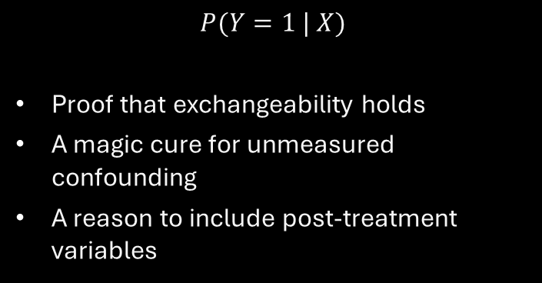
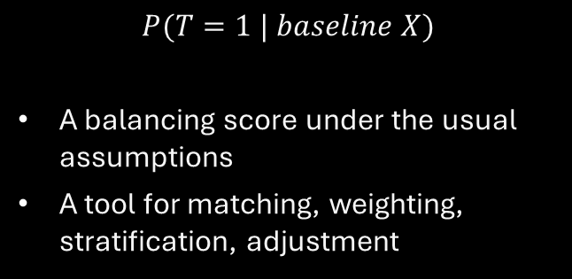
What the Propensity Score is, and is Not
It IS
It is NOT
$$P(T=1 | baseline X)$$
A balancing score under the usual assumptions
A tool for matching, weighting, stratification, adjustment
$$P(Y=1 | X)$$
Proof that exchangeability holds
A magic cure for unmeasured confounding
A reason to include post-treatment variables
Propensity methods can balance measured covariates, not variables you never measured.

Slide 5
Why Can One Number Help?
$$Y(t) ⟂ T | X ⇒ Y(t) ⟂ T | e(X)$$
Before
After
Matching directly on age, BP, diabetes, smoking, income, etc. quickly becomes difficult.
Use e(X) as a scalar summary of treatment assignment to find comparable units.
Important: the balancing result depends on the causal assumptions and a useful propensity-score model.

Slide 6
Which Covariates Belong in the PS Model?
Usually include
Be cautious
Do NOT include
True confounders
Strong baseline predictors of outcome
Pre-treatment variables related to treatment and/or outcome
Weak instruments / treatment-only predictors can worsen variance
Highly redundant predictors may not help balance
Post-treatment mediators
Post-treatment colliders
Variables caused by treatment
Use causal knowledge first; prediction accuracy is not the objective.

Slide 7
Estimating the Propensity Score in R
Logistic regression
Interpretation
A patient with ps = 0.78 had an estimated 78% probability of receiving treatment, given measured baseline X.
Model can be logistic regression, GAM, trees, boosting, etc., but balance remains the target.
ps_mod <- glm(T ~ age + bp + diabetes + smoking,
data = dat, family = binomial())
dat$ps <- predict(ps_mod, type = "response")
Do not choose a PS model only because it has the highest AUC.

Slide 8
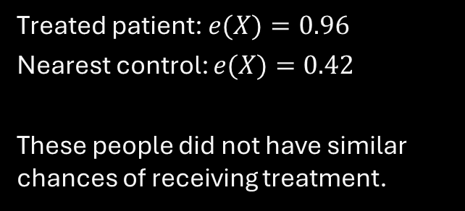
Poor Overlap: A Warning, Not Just a Nuisance
Example
What this means
Treated patient: $e(X)=0.96$
Nearest control: $e(X)=0.42$
These people did not have similar chances of receiving treatment.
The data provide little information about the missing counterfactual.
Matching may discard units.
IPW will later create extreme weights.
Positivity is a causal assumption; overlap is its empirical footprint.

Slide 9
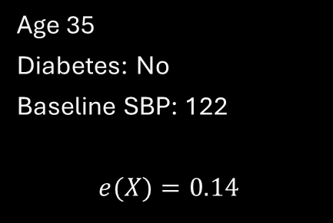
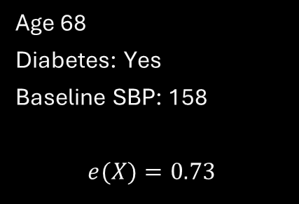
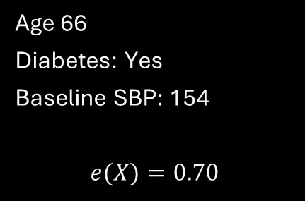
Matching: The Core Idea
Treated patient
Bad control
Better control
Age 68
Diabetes: Yes
Baseline SBP: 158
$$e(X)=0.73$$
Age 35
Diabetes: No
Baseline SBP: 122
$$e(X)=0.14$$
Age 66
Diabetes: Yes
Baseline SBP: 154
$$e(X)=0.70$$
Match people who had similar treatment probabilities before treatment.

Slide 10



Nearest-Neighbor Matching
For treated $i$, choose control j minimizing $| e(Xᵢ) − e(Xⱼ) |$
Treated
Control A
Control B
$$e(X)=0.71$$
$$e(X)=0.69$$
$$e(X)=0.43$$
Nearest neighbor would prefer Control A: but 'nearest' does not guarantee 'close enough'.

Slide 11
Calipers: Prevent Terrible Matches
Accept match only if $|e(X_{i}) − e(X_{j})|$ < caliper
Without a caliper
With a caliper
A treated unit may be matched to a distant control simply because that is the nearest available one.
Poor matches are rejected. Some treated units may remain unmatched.
Trade-off: better comparability can reduce the matched sample size.

Slide 12
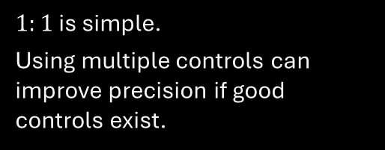

Matching Choices Change the Analysis
$$1:1 vs 1:k$$
With replacement
Without replacement
$1:1$ is simple.
Using multiple controls can improve precision if good controls exist.
A strong control can be reused.
Often improves match quality.
Requires correct variance handling.
Each control used once.
More intuitive sample, but later matches can become worse.
Matching is a design decision, not a single automatic procedure.

Slide 13
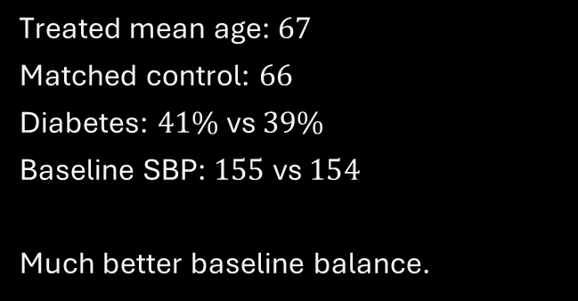
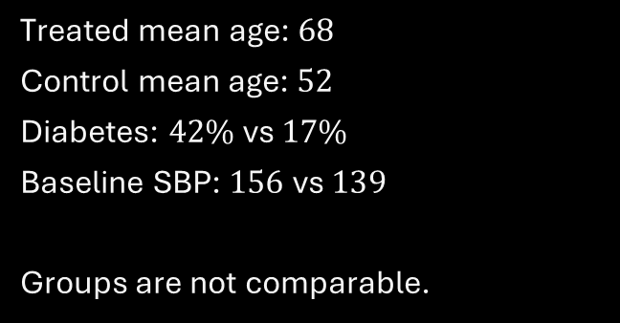
Before Matching vs After Matching
Before
After
Treated mean age: $68$
Control mean age: $52$
Diabetes: $42\%$ vs $17\%$
Baseline SBP: $156$ vs $139$
Groups are not comparable.
Treated mean age: $67$
Matched control: $66$
Diabetes: $41\%$ vs $39\%$
Baseline SBP: $155$ vs $154$
Much better baseline balance.
Matching is successful only if it improves balance on the baseline covariates.

Slide 14
What Estimand Does Matching Target?
Typical treated-to-control matching
But not always
Start with treated units.
Find comparable controls.
Estimate effect in the matched treated population.
Often naturally targets ATT.
Target depends on the matching design.
Trimming changes the population.
Full matching / weighting-like methods can target different estimands.
Always name the target population before interpreting the effect.

Slide 15
What Matching Does NOT Solve
Unmeasured confounding
Poor overlap
Bad causal variable choice
Matching balances measured X.
Hidden common causes can still bias the effect.
Some units may have no credible match.
Discarding them changes the target population.
Matching on mediators/colliders can create bias.
PS methods do not replace DAG reasoning.
Matching can make groups look similar.
Causal validity still requires assumptions.

Slide 16
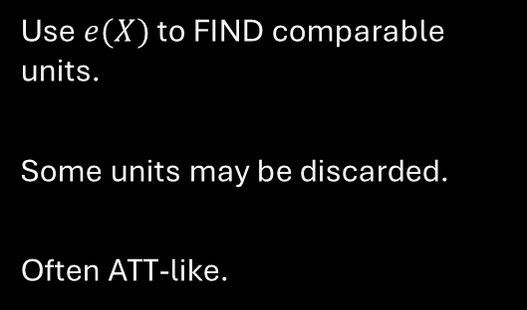
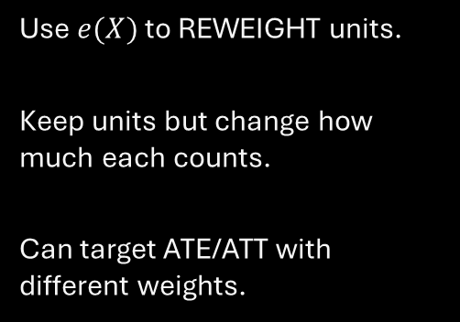
Bridge: Matching $→$ IPW $→$ AIPW
Matching
IPW
AIPW
Use $e(X)$ to FIND comparable units.
Some units may be discarded.
Often ATT-like.
Use $e(X)$ to REWEIGHT units.
Keep units but change how much each counts.
Can target ATE/ATT with different weights.
Combine weighting with an outcome model.
Two modeling components.
Doubly robust under standard conditions.
Same propensity score idea: three different ways to build the causal comparison.

Slide 17


Slide 18
IPW: changing each person’s contribution
Matching selects comparison participants.
Weighting assigns a numerical contribution to each observed participant.
The goal is to align covariate distributions for a chosen causal target.
We continue with training, baseline X, and 1978 earnings.
IPW uses treatment probabilities to construct the comparison.

Slide 19
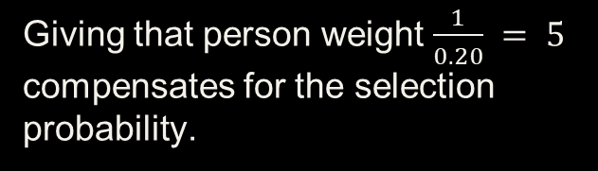
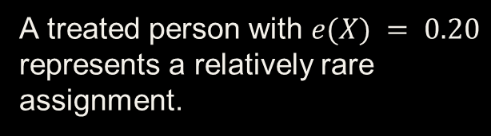
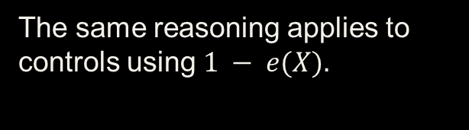
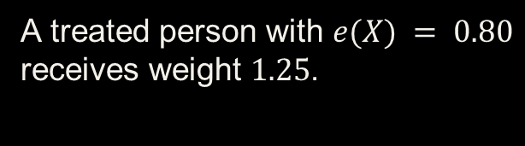
Why inverse probabilities?
A treated person with $e(X) = 0.20$ represents a relatively rare assignment.
Giving that person weight $\frac{1}{0.20} = 5$ compensates for the selection probability.
A treated person with $e(X) = 0.80$ receives weight $1.25$.
The same reasoning applies to controls using $1 − e(X).$
Less likely observed assignments receive larger ATE weights.

Slide 20
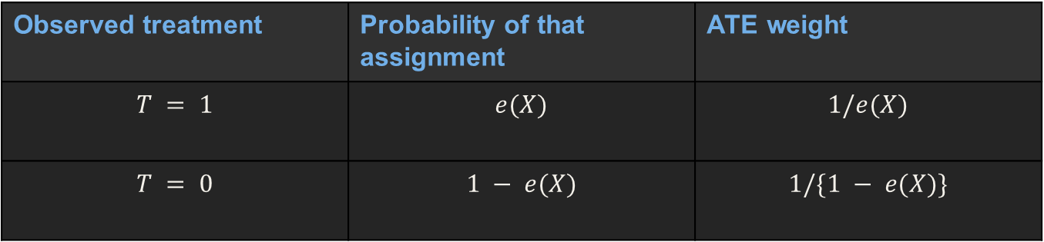
ATE weights
Observed treatment | Probability of that assignment | ATE weight
$$T = 1$$ | $$e(X)$$ | $$1/e(X)$$
$$T = 0$$ | $$1 − e(X)$$ | $$1/\{1 − e(X)\}$$
$$w_{i} =\frac{T_{i}}{{\hat{e}}_{i}} +\frac{1 − T_{i}}{1 −{\hat{e}}_{i}}$$

Slide 21
Actual weights for job-training participants
Participant | T | Estimated score | ATE weight
NSW1 | 1 | 0.639 | 1.57
NSW11 | 1 | 0.689 | 1.45
PSID1 | 0 | 0.026 | 1.03
PSID16 | 0 | 0.056 | 1.06
For an untreated participant, use 1/(1 − score), not 1/score.

Slide 22
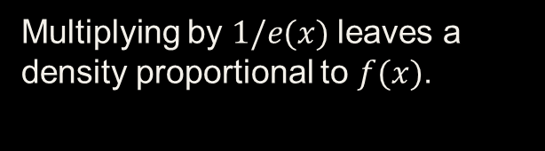
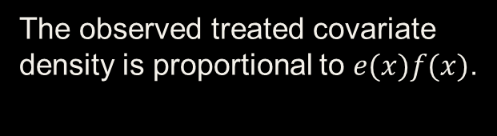
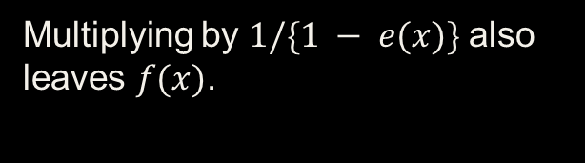
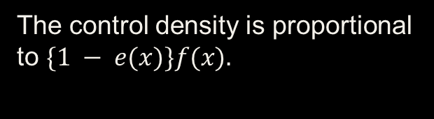
Why weighting balances the population
The observed treated covariate density is proportional to $e(x)f(x)$.
Multiplying by $1/e(x)$leaves a density proportional to $f(x)$.
The control density is proportional to $\{1 − e(x)\}f(x).$
Multiplying by $1/\{1 − e(x)\}$also leaves $f(x)$.
With the true probabilities, both ATE-weighted arms target the same $f(x)$.

Slide 23
Why IPW identifies a treatment mean
$$E[TY/e(X) | X] = E[Y | T = 1, X].$$
Because $E[TY | X] = e(X)E[Y | T = 1, X].$
Averaging over X gives $E[TY/e(X)] = E[Y(1)].$
The control expression identifies $E[Y(0)]$in the same way.
Exchangeability, consistency, and positivity justify the causal equality.

Slide 24
Weighted mean estimators
Horvitz-Thompson: ${\hat{μ}}_{1} = n⁻¹ Σ T_{i}Y_{i}/{\hat{e}}_{i}.$
Normalized mean: ${\hat{μ}}_{1} = Σ T_{i}Y_{i}/{\hat{e}}_{i}÷ Σ T_{i}/{\hat{e}}_{i}.$ (Hajek)
Compute the corresponding control mean using $1 −{\hat{e}}_{i}.$
The effect estimate is $\hat{τ} ={\hat{μ}}_{1} −{\hat{μ}}_{2}$.
Our real-data calculations use normalized weighted means.

Slide 25
R: estimate the assignment model
library(MatchIt)
data("lalonde", package = "MatchIt")
d <- lalonde
ps_fit <- glm(treat ~ age + educ + race + married +
nodegree + re74 + re75,
family = binomial(), data = d)
d$ps <- predict(ps_fit, type = "response")
stopifnot(all(d$ps > 0 & d$ps < 1))
This check prevents invalid denominators. It does not verify population positivity.

Slide 26
R: ATE weights and point estimate
d$w_ate <- ifelse(d$treat == 1,
1 / d$ps, 1 / (1 - d$ps))
mu1 <- with(d, weighted.mean(re78[treat == 1],
w_ate[treat == 1]))
mu0 <- with(d, weighted.mean(re78[treat == 0],
w_ate[treat == 0]))
ate_ipw <- mu1 - mu0
c(mu1 = mu1, mu0 = mu0, ATE = ate_ipw)
The target is the overall population represented by these study data.

Slide 27
ATE weighting: real-data results
Quantity | Estimate
Weighted training mean | $6,648
Weighted comparison mean | $6,423
Weighted difference | About +$225
This is an estimate under the proposed model and assumptions, not a validated causal conclusion.

Slide 28
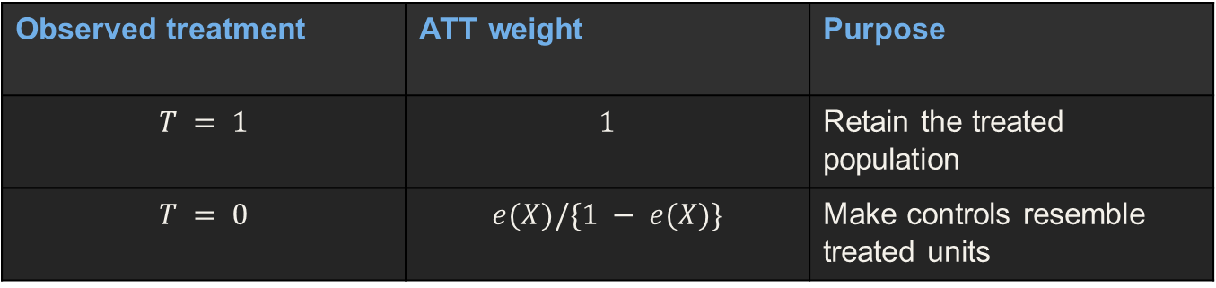
ATT weighting
Observed treatment | ATT weight | Purpose
$$T = 1$$ | $$1$$ | Retain the treated population
$$T = 0$$ | $$e(X)/\{1 − e(X)\}$$ | Make controls resemble treated units
ATT weights target the treated covariate distribution, not the full-population ATE.

Slide 29
R: ATT weights and point estimate
d$w_att <- ifelse(d$treat == 1,
1, d$ps / (1 - d$ps))
mu1_att <- with(d, weighted.mean(re78[treat == 1],
w_att[treat == 1]))
mu0_att <- with(d, weighted.mean(re78[treat == 0],
w_att[treat == 0]))
att_ipw <- mu1_att - mu0_att
c(mu1 = mu1_att, mu0 = mu0_att, ATT = att_ipw)
Here the treated mean stays $6,349. The weighted control mean is about $5,135.

Slide 30
ATE and ATT answer different questions
Target | Weighting estimate | Whose effect?
ATE | About +$225 | Overall study population
ATT | About +$1,214 | Treated participants
Different targets can produce different effects, even with the same data and propensity model.

Slide 31
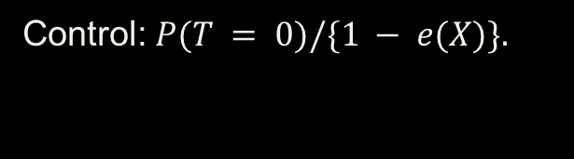

Stabilized ATE weights
Treated: $P(T = 1)/e(X)$.
Control: $P(T = 0)/\{1 − e(X)\}.$
The numerators multiply all weights within an arm by the same constant.
Use the observed treatment fraction to estimate the numerators.
Normalized arm means are unchanged. Stabilization does not fix poor overlap.

Slide 32
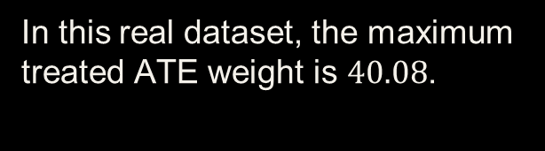
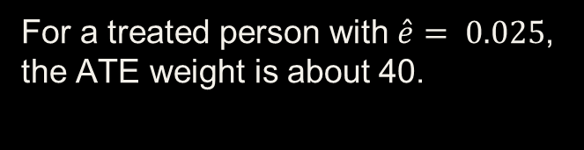
Extreme weights and influence
For a treated person with $\hat{e}= 0.025$, the ATE weight is about 40.
In this real dataset, the maximum treated ATE weight is $40.08$.
A small number of low-score treated people can drive the weighted treated mean.
Check the weight distribution separately in each arm.
Retaining everyone does not mean everyone contributes equally.

Slide 33
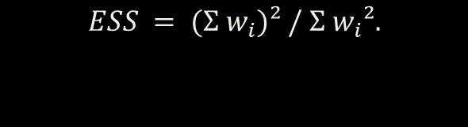
Effective sample size
Equal weights give ESS equal to the observed sample size.
$$ESS = (Σ w_{i})² / Σ w_{i}².$$
Compute ESS within each treatment arm.
A few dominant weights lower ESS.
ESS describes weight concentration, not a new count of independent participants.

Slide 34
Weight diagnostics in the real data
Design | Treated n | Treated ESS | Control n | Control ESS
ATE weights | 185 | 58.3 | 429 | 329.0
ATT weights | 185 | 185.0 | 429 | 99.8
ATE weights concentrate influence among treated units. ATT weights concentrate it among controls.

Slide 35
R: inspect weights and ESS
ess <- function(w) sum(w)^2 / sum(w^2)
q <- c(0, .5, .9, .95, .99, 1)
tapply(d$w_ate, d$treat, quantile, probs = q)
tapply(d$w_ate, d$treat, ess)
tapply(d$w_att, d$treat, ess)
# Largest ATE weights and their underlying scores
ix <- order(d$w_ate, decreasing = TRUE)[1:5]
d[ix, c("treat", "ps", "w_ate", "age", "re74", "re75")]
Inspect the people behind the largest contributions.

Slide 36
R: calculate the chart’s balance values
X <- data.frame(age=d$age, educ=d$educ, married=d$married,
nodegree=d$nodegree, re74=d$re74, re75=d$re75,
black=as.numeric(d$race == "black"))
A <- d$treat
sref <- sapply(X[A == 1, ], sd)
smd <- function(w) sapply(seq_along(X), function(j) {
x <- X[[j]]
abs(weighted.mean(x[A == 1], w[A == 1]) -
weighted.mean(x[A == 0], w[A == 0])) / sref[j]
})
Use one fixed denominator before and after weighting.

Slide 37
R: reproduce the balance plot
balance <- rbind(
Before = smd(rep(1, nrow(d))),
ATE = smd(d$w_ate), ATT = smd(d$w_att))
barplot(balance, beside = TRUE,
names.arg = names(X), cex.names = .75,
col = c("grey70", "#71AFE8", "#7CCB91"),
ylab = "Absolute SMD", ylim = c(0, 2),
legend.text = rownames(balance),
args.legend = list(x = "top", bty = "n"))
abline(h = .10, lty = 2, col = "red")
The dashed 0.10 line is a guideline, not a test of exchangeability.

Slide 38
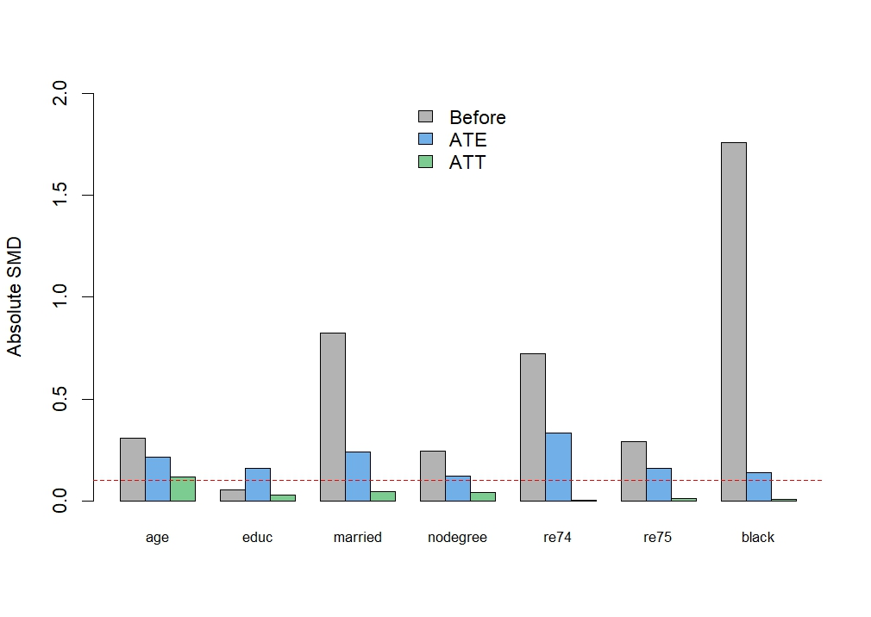
Balance after weighting

Slide 39
Poor overlap: possible responses
Improve the propensity specification if important modeled terms are missing.
Reconsider whether the full-population ATE is supported.
Restriction changes the target population. Weight capping can introduce bias.
Recheck balance and sensitivity after any change.
A numerical weight modification cannot restore missing support.

Slide 40
Uncertainty and the next estimator
Use inference that accounts for the weighting analysis and any clustering.
A suitable refitting bootstrap can include propensity-model estimation for smooth IPW.
Sampling intervals do not quantify unmeasured confounding.
Next, AIPW combines outcome predictions with weighted residual corrections.
IPW depends on the treatment model. AIPW adds an outcome-model safeguard.

Slide 41
AIPW: why combine the two approaches?
G-computation predicts outcomes under training and no training.
IPW uses treatment probabilities to reconstruct comparable populations.
Each approach depends on a different statistical model.
AIPW combines predictions with weighted observed prediction errors.
Our target in this section is the same full-study-population ATE.

Slide 42
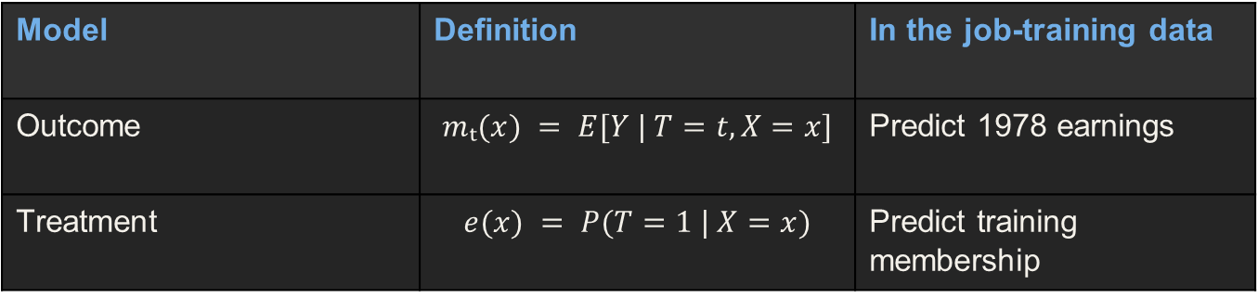
The two models
Model | Definition | In the job-training data
Outcome | $$mₜ(x) = E[Y | T=t, X=x]$$ | Predict 1978 earnings
Treatment | $$e(x) = P(T=1 | X=x)$$ | Predict training membership
Both models use the baseline adjustment set justified by the causal question.

Slide 43
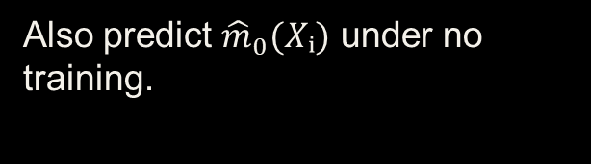
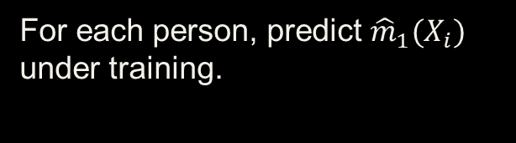
Start with outcome predictions
For each person, predict ${\hat{m}}_{1}(X_{i})$ under training.
Also predict ${\hat{m}}_{0}(Xᵢ)$ under no training.
If the outcome model is wrong, prediction errors may systematically affect the mean.
G-computation averages these predictions over all participants.
AIPW starts with the same predictions, then adds a correction.

Slide 44
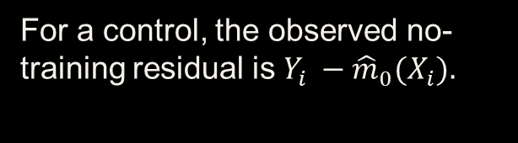
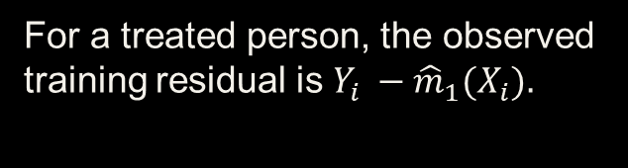
Observed residuals supply the correction
For a treated person, the observed training residual is $Y_{i} −{\hat{m}}_{1}(X_{i}).$
For a control, the observed no-training residual is $Y_{i} −{\hat{m}}_{0}(X_{i}).$
We only observe the residual in the arm received.
Inverse probabilities adjust which people supply those residuals.
The correction uses observed outcomes without inventing missing residuals.

Slide 45
The augmented training mean
$$ψ_{1i} ={\hat{m}}_{1}(X_{i}) + T_{i}\{Y_{i} −{\hat{m}}_{1}(X_{i})\}/{\hat{e}}_{i}.$$
Every person contributes a predicted training outcome.
Only treated people contribute a training residual correction.
$${\hat{μ}}_{1,AIPW} = n^{−1}Σ_{i} ψ_{1i}.$$
Prediction + inverse-probability-weighted residual

Slide 46
The augmented no-training mean
$$ψ_{1i} ={\hat{m}}_{0}(X_{i}) +(1−T_{i})\{Y_{i} −{\hat{m}}_{0}(X_{i})\}/(1−{\hat{e}}_{i}).$$
Every person contributes a predicted no-training outcome.
Only controls contribute a no-training residual correction.
$${\hat{μ}}_{0,AIPW} = n^{−1}Σ_{i} ψ_{0i}.$$
Both means average over the same target population.

Slide 47
AIPW ATE
$${\hat{τ}}_{AIPW} = n^{−1}Σ_{i} \left[ψ_{1i} − ψ_{0i}\right].$$
Prediction contrast: ${\hat{m}}_{1}\left(X_{i}\right) −{\hat{m}}_{0}\left(X_{i}\right).$
Add the treated residual correction $T_{i}\{Y_{i} −{\hat{m}}_{1}(X_{i})\}/{\hat{e}}_{i}$.
Subtract the control residual correction $\left(1 − T_{i}\right)\{Y_{i} −{\hat{m}}_{0}(X_{i})\}/(1 −{\hat{e}}_{i}).$
The control correction enters with a minus sign.

Slide 48
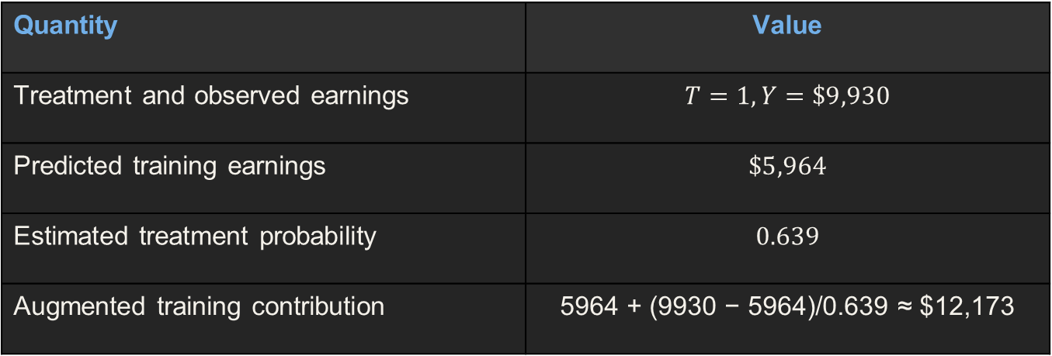
Worked real participant: NSW1
Quantity | Value
Treatment and observed earnings | $$T=1, Y=\$9,930$$
Predicted training earnings | $$\$5,964$$
Estimated treatment probability | $$0.639$$
Augmented training contribution | 5964 + (9930 − 5964)/0.639 ≈ $12,173
Its control contribution is the prediction ${\hat{m}}_{0}(X) ≈ \$4,416$.

Slide 49
Worked real participant: PSID1
Quantity | Value
Treatment and observed earnings | T=0, Y=$25,565
Predicted no-training earnings | $15,935
Estimated treatment probability | 0.026
Augmented control contribution | 15935 + (25565 − 15935)/(1 − 0.026) ≈ $25,823
Its training contribution is the prediction ${\hat{m}}_{1}(X) ≈ \$17,483$.

Slide 50
Why it works: a correct outcome model
Suppose ${\hat{m}}_{1}(X)$ converges to the true $m_{1}(X)$.
Then $E[Y − m_{1}(X) | T=1, X] = 0.$
The weighted residual correction has conditional expectation zero.
The average prediction identifies $E[Y(1)].$
A correct outcome model makes the correction mean-zero.

Slide 51
Why it works: a correct propensity model
Suppose $\hat{e}(X)$ converges to the true $e(X)$.
Let ${\tilde{m}}_{1}(X)$ be a possibly wrong outcome-model limit.
$$E[{\tilde{m}}_{1}(X) + T\{Y −{\tilde{m}}_{1}(X)\}/e\left(X\right) | X]$$
$$={\tilde{m}}_{1}\left(X\right)+ m_{1}(X) −{\tilde{m}}_{1}(X)= m_{1}(X).$$
Correct assignment probabilities remove the limiting prediction error.

Slide 52
Two errors interact in the remaining bias
Let g(X) be the propensity-model limit.
Let ${\tilde{m}}_{1}(X)$ be the outcome-model limit.
Bias of the augmented training mean:
$$E\left[\frac{\left\{g\left(X\right)− e\left(X\right)\right\}\left\{{\tilde{m}}_{1}\left(X\right)− m_{1}\left(X\right)\right\}}{g\left(X\right)}\right].$$
If either error is zero, this bias term vanishes.

Slide 53
What double robustness does not fix
An unmeasured confounder can invalidate both model-based causal interpretations.
Missing support can prevent identification for part of the target population.
Scores near 0 or 1 can create extreme residual corrections.
Two misspecified models can still yield a biased estimate.
Double robustness concerns statistical models, not a replacement for causal assumptions.

Slide 54
R: fit the outcome and treatment models
library(MatchIt)
data("lalonde", package = "MatchIt")
d <- lalonde
f_x <- ~ age + educ + race + married + nodegree + re74 + re75
fit_y <- lm(update(f_x, re78 ~ treat + .), data = d)
fit_e <- glm(update(f_x, treat ~ .),
family = binomial(), data = d)
m1 <- predict(fit_y, transform(d, treat = 1))
m0 <- predict(fit_y, transform(d, treat = 0))
e <- predict(fit_e, type = "response")
The outcome model predicts earnings. The treatment model predicts assignment.

Slide 55
R: calculate augmented contributions
A <- d$treat
Y <- d$re78
stopifnot(all(e > 0 & e < 1))
psi1 <- m1 + A * (Y - m1) / e
psi0 <- m0 + (1 - A) * (Y - m0) / (1 - e)
psi <- psi1 - psi0
ate_aipw <- mean(psi)
c(mu1 = mean(psi1), mu0 = mean(psi0), ATE = ate_aipw)
Prediction errors use observed minus predicted outcomes.

Slide 56
R: compare the same ATE target
ate_g <- mean(m1 - m0)
w <- ifelse(A == 1, 1 / e, 1 / (1 - e))
ate_ipw <- weighted.mean(Y[A == 1], w[A == 1]) -
weighted.mean(Y[A == 0], w[A == 0])
c(G_computation = ate_g,
IPW_normalized = ate_ipw,
AIPW = ate_aipw)
All three calculations target the overall study-population ATE.

Slide 57
Real-data estimates
Method | ATE estimate | Main statistical dependence
G-computation | About +$1,548 | Outcome model
Normalized IPW | About +$225 | Propensity model
AIPW | About +$887 | Either model for consistency
AIPW’s position between these estimates does not prove it is closest to the truth.

Slide 58
What changed relative to g-computation?
Average predicted training earnings $≈ \$7,875$.
Training residual correction $≈ −\$557,$giving$\$7,318$.
Average predicted control earnings $≈ \$6,326.$
Control residual correction $≈ +\$104$, giving $\$6,431$.
AIPW difference: $7318 − 6431 ≈ \$887$.

Slide 59
Uncertainty: what the simple score SE requires
When both nuisance functions are consistently estimated and suitable regularity holds:
${\hat{φ}}_{i} = ψ_{i} −{\hat{τ}}_{AIPW}$approximates an influence contribution.
$SE ≈ sd(ψ_{i})/\sqrt{n}$, with a normal confidence interval.
Consistency with one correct model alone does not justify this SE universally.
Use a variance procedure justified for the fitted models and target.

Slide 60
R: a refitting bootstrap function
estimate_aipw <- function(z) {
fy <- lm(re78 ~ treat + age + educ + race + married +
nodegree + re74 + re75, data = z)
fe <- glm(treat ~ age + educ + race + married +
nodegree + re74 + re75, binomial(), data = z)
p <- predict(fe, type = "response")
y1 <- predict(fy, transform(z, treat = 1))
y0 <- predict(fy, transform(z, treat = 0))
A <- z$treat; Y <- z$re78
mean(y1 - y0 + A*(Y-y1)/p - (1-A)*(Y-y0)/(1-p))
}
Each resample refits both models before calculating AIPW.

Slide 61
R: bootstrap uncertainty
set.seed(7900)
B <- 500
boot_est <- replicate(B, {
idx <- sample.int(nrow(d), replace = TRUE)
estimate_aipw(d[idx, ])
})
stopifnot(all(is.finite(boot_est)))
boot_se <- sd(boot_est)
ci <- ate_aipw + c(-1, 1) * qnorm(.975) * boot_se
c(ATE = ate_aipw, SE = boot_se, lower = ci[1], upper = ci[2])
Inspect resampling stability and convergence warnings before reporting the interval.

Slide 62
Flexible models and cross-fitting
Flexible models can estimate nonlinear outcome and assignment functions.
Fit nuisance models outside each held-out fold.
Compute each held-out participant’s score using those excluded-data fits.
Average all held-out scores and assess the required convergence conditions.
Cross-fitting limits overfitting effects. It does not fix confounding or support.

Slide 63
AIPW: the main lesson
Outcome predictions supply the treatment and control means.
Weighted factual residuals correct systematic prediction errors.
Either correctly specified nuisance side can protect consistency.
Causal assumptions, overlap, and suitable uncertainty quantification remain essential.
The final report should state the target, models, diagnostics, estimate, and limitations.

Slide 64
Does the Treatment Effect Differ Across People?
ATE = E[Y(1) − Y(0)]
So far
Next
Estimate one average causal effect for the target population.
Ask whether the effect changes with baseline characteristics X.
This is heterogeneous treatment effect (HTE) analysis.

Slide 65
Why the Average Can Be Misleading
Subgroup A
Subgroup B
Treatment effect = +10
Treatment effect = −10
If both groups are equally common: ATE = 0
An average effect of zero does not mean the treatment does nothing for everyone.

Slide 66
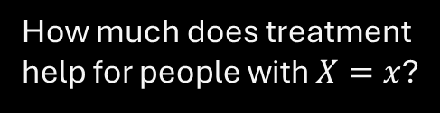
From ATE to CATE
$$CATE(x) = E[Y(1) − Y(0) | X = x]$$
ATE
CATE
Examples
How much does treatment help on average?
How much does treatment help for people with $X=x$?
Age, disease severity, biomarker, baseline risk.
ATE averages over X; CATE conditions on X.

Slide 67
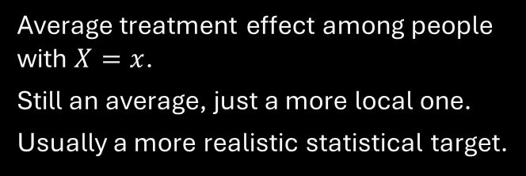
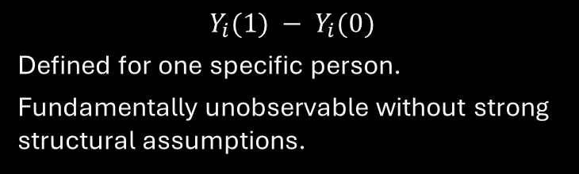
CATE Is Not an Individual Treatment Effect
Individual treatment effect
CATE(x)
$$Y_{i}(1) − Y_{i}(0)$$
Defined for one specific person.
Fundamentally unobservable without strong structural assumptions.
Average treatment effect among people with $X=x$.
Still an average, just a more local one.
Usually a more realistic statistical target.
HTE typically means variation in average effects across covariate profiles.

Slide 68
Effect Modifier $≠$ Confounder
Confounder
Effect modifier
Affects treatment assignment and outcome.
Creates a noncausal backdoor path.
Needs control for identification.
Changes the magnitude or direction of the treatment effect.
Answers: 'For whom does treatment work better?'
May or may not also be a confounder.
A variable can be both: but confounding and effect modification are different causal roles.

Slide 69
Real-World Heterogeneity: Medicine
Baseline risk
Biomarker
Age / frailty
A statin may prevent more absolute events in high-risk patients.
A targeted cancer therapy may work mainly in biomarker-positive tumors.
Benefit and toxicity may differ across age or frailty levels.
Clinical decisions are often about who benefits most.

Slide 70
Real-World Heterogeneity: Education and Policy
Education
Policy
Tutoring may benefit lower-performing students more.
Technology interventions may differ by prior achievement or access.
Job training may help workers with weak labor-market attachment more.
Cash transfers may have different effects by baseline income.
HTE turns one average policy effect into a targeting question.

Slide 71






A Simple Two-Subgroup Example
Group
Control mean
Treatment mean
Effect
Low baseline risk
$$20$$
$$18$$
$$−2$$
High baseline risk
$$40$$
$$30$$
$$−10$$
Same treatment, different causal effect across baseline risk.

Slide 72


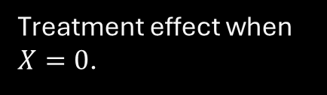

Starting Point: Treatment $×$ Covariate Interaction
$$Y = β₀ + β₁T + β₂X + β₃(T×X) +ε$$
$$β₁$$
$$β₂$$
$$β₃$$
Treatment effect when $X=0$.
Outcome association with X in the control arm.
How the treatment effect changes as X changes.
$$τ(x) = β₁ + β₃x$$

Slide 73
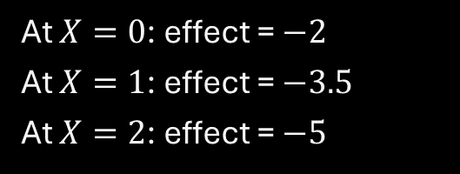

How to Read an Interaction
Suppose
Then
$β₁ = −2$ and $β₃ = −1.5$
At $X=0$: effect = $−2$
At $X=1$: effect = $−3.5$
At $X=2$: effect = $−5$
A nonzero interaction means the treatment effect changes with X.

Slide 74
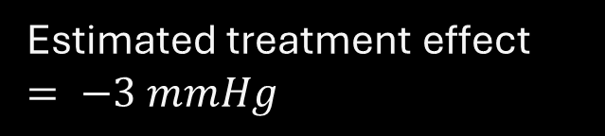

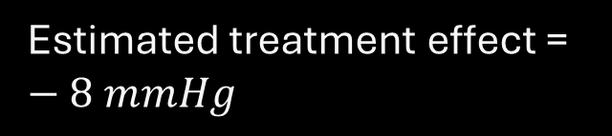

Binary Effect Modifier Example
No diabetes $(X=0)$
Diabetes $(X=1)$
Estimated treatment effect $= −3 mmHg$
Estimated treatment effect = $−8 mmHg$
Interaction asks whether −8 and −3 differ beyond sampling variation.

Slide 75
Subgroup Analysis Can Go Wrong
Small subgroups
Post hoc fishing
Arbitrary cutpoints
Noisy estimates
Wide confidence intervals
Unstable signs
Try enough subgroups and something will look significant.
False discoveries multiply.
Age 59 vs 60
Risk 9.9% vs 10.1%
Artificial discontinuities
HTE is harder than ATE because we estimate many local effects.

Slide 76
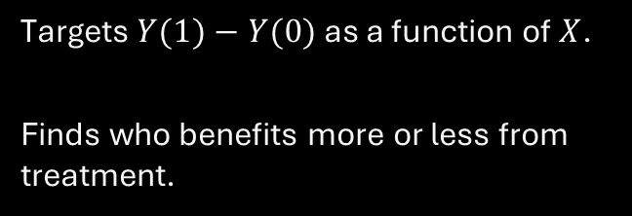
Prediction Is Not Treatment-Effect Heterogeneity
Prognostic model
HTE model
Predicts Y well.
Finds who is high risk.
High risk does not necessarily mean larger treatment benefit.
Targets $Y(1)−Y(0)$ as a function of $X$.
Finds who benefits more or less from treatment.
High outcome risk $≠$ high treatment benefit.

Slide 77
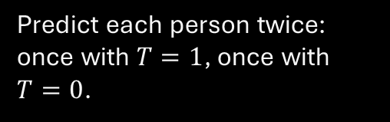
S-Learner: One Flexible Outcome Model
Fit one model: $m(T,X) = E[Y | T,X]$
Step 1
Step 2
Step 3
Fit one regression / ML model using T and X.
Predict each person twice: once with $T=1$, once with $T=0$.
Subtract the two predictions.
$$\hat{τ}(x) =\hat{m}(1,x) −\hat{m}(0,x)$$

Slide 78

T-Learner: Separate Models by Treatment Arm
$m₁(x)=E[Y|T=1,X=x]$ $m₀(x)=E[Y|T=0,X=x]$
Treatment model
Control model
CATE
Fit outcome model using treated observations only.
Fit outcome model using control observations only.
$$τ ̂(x) =m ̂(1,x) −m ̂(0,x)$$
T-learner allows the two response surfaces to be very different.

Slide 79
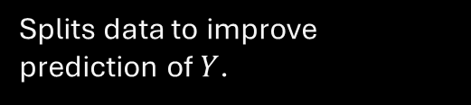
Causal Forests: A Preview
Ordinary random forest
Causal forest
Output
Estimated CATE by covariate profile.
Variable importance for heterogeneity.
Uncertainty tools.
Splits data to improve prediction of $Y$.
Splits data to find regions where treatment effects differ.
Goal: not 'who has high Y?' but 'where is the treatment contrast different?'

Slide 80
HTE Still Needs the Same Causal Assumptions
$Y(t) ⟂ T | X$+ positivity + consistency
Exchangeability
Positivity
Consistency
Within X, treated and untreated are comparable for potential outcomes.
Relevant X-profiles need treatment and control support.
Observed outcome corresponds to the treatment actually received.
Flexible ML does not make unmeasured confounding disappear.

Slide 81
Next Class: HTE in Detail
1. Regression interactions
2. Meta-learners
3. Modern HTE
Binary and continuous effect modifiers
How to plot τ(x)
Confidence intervals
S-learner
T-learner
X-learner
When each is useful
Causal forests
Sample splitting / validation
Clinical targeting
R implementation
For today, remember: 'For whom is the treatment effect different?'

